Slide 1
Understanding the median
Numerical summaries of data

Slide 2
how to use Oak lessons

Slide 3
I can understand what the median is measuring, how it is measuring it and find the median from data presented in a list.

Slide 4
A measure of central tendency is a summary measure that attempts to describe a whole set of data with a single value that represents the middle or centre of its distribution.
Data are a collection of information.

Slide 5
Median - we will explore this in the lesson

Slide 6

Understanding the median
Finding the middle in small data sets
Finding the middle in large data sets

Slide 7
Finding the middle in small data sets
Which number is the middle value?
17
45
85

Slide 8
Finding the middle in small data sets
Which number is the middle value?
18
92
63
least
greatest
middle

Slide 9
Finding the middle in small data sets
Which number is the middle value?
8
58
26
74
91

Slide 10
Finding the middle in small data sets
Which number is the middle value?
88
80
2
82
22
20
28

Slide 11
Finding the middle in small data sets
The median is a type of average as such it is a measure of central tendency.
A measure of central tendency is a single value which attempts to describe the data set by finding a central value.
The median is the central (middle) piece of data when the data are in numerical order.

Slide 12
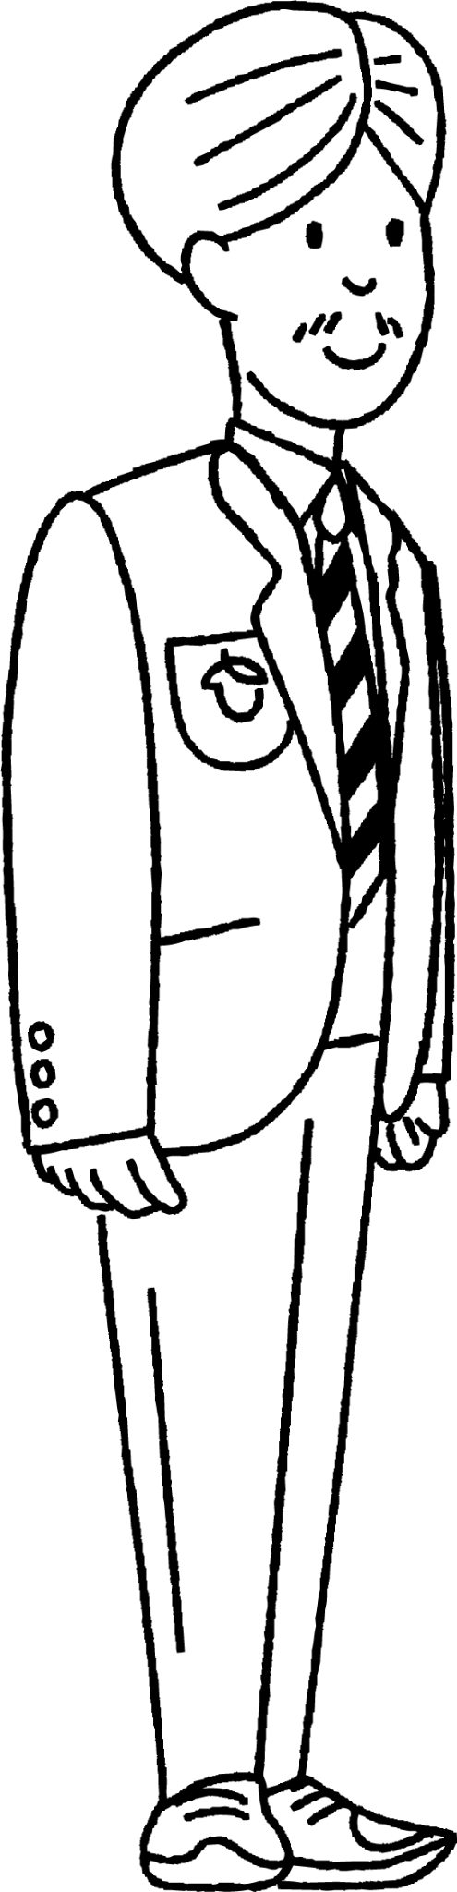
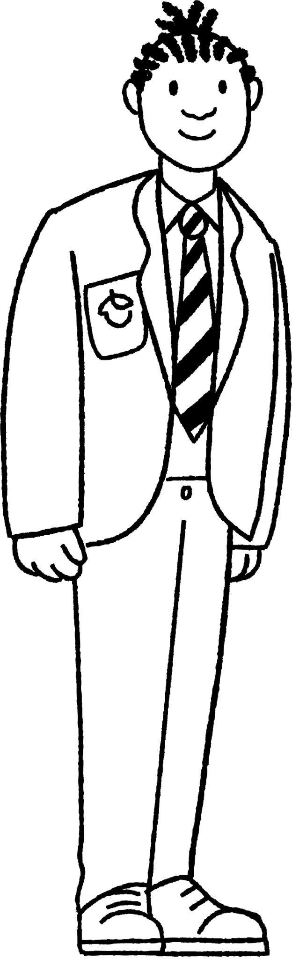
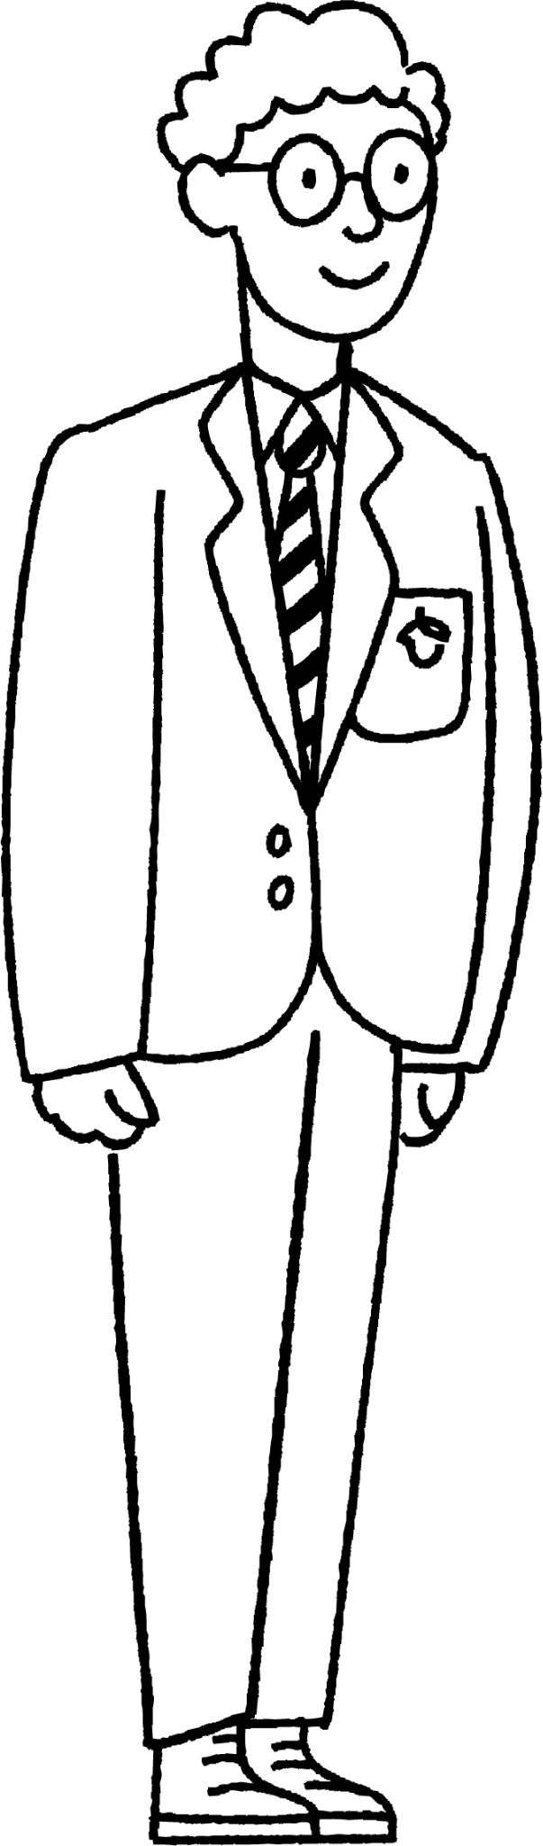
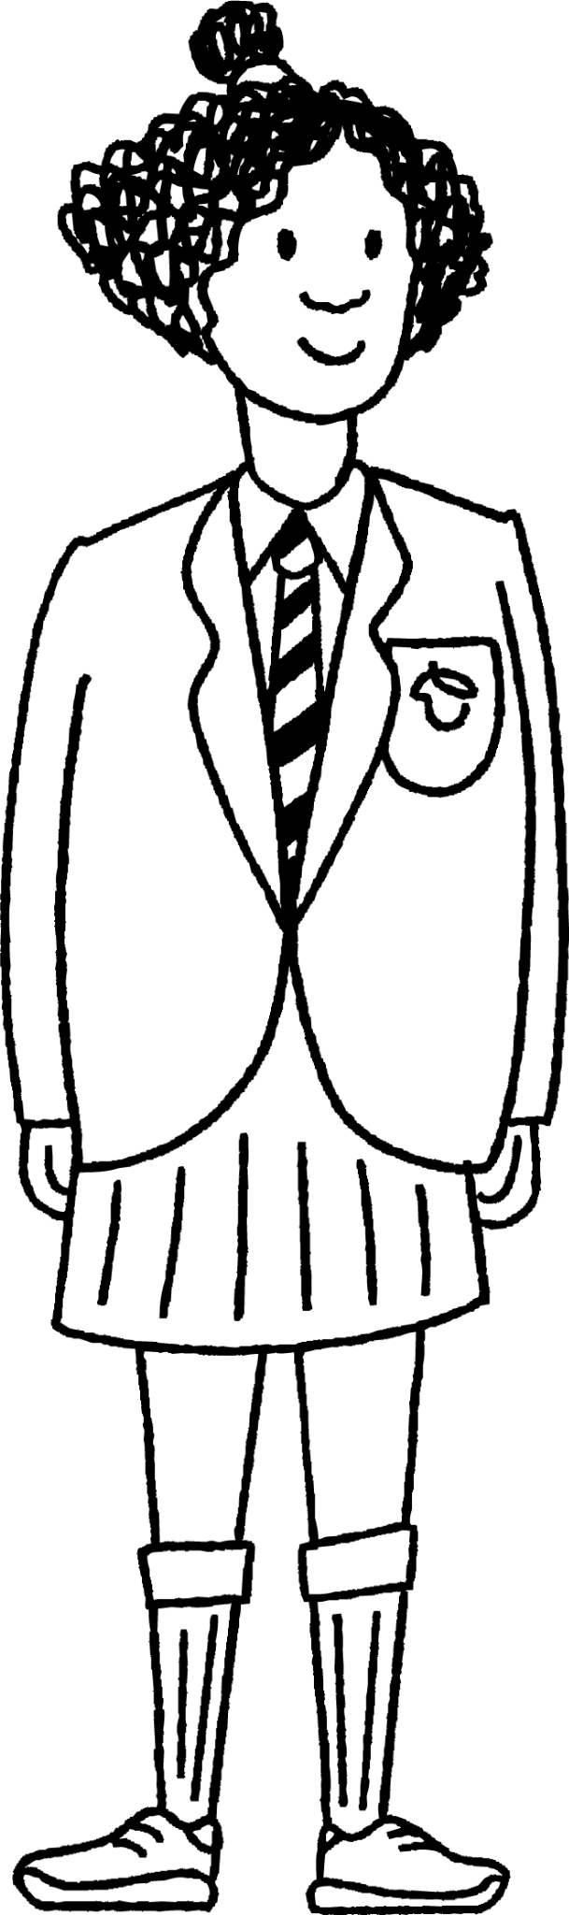
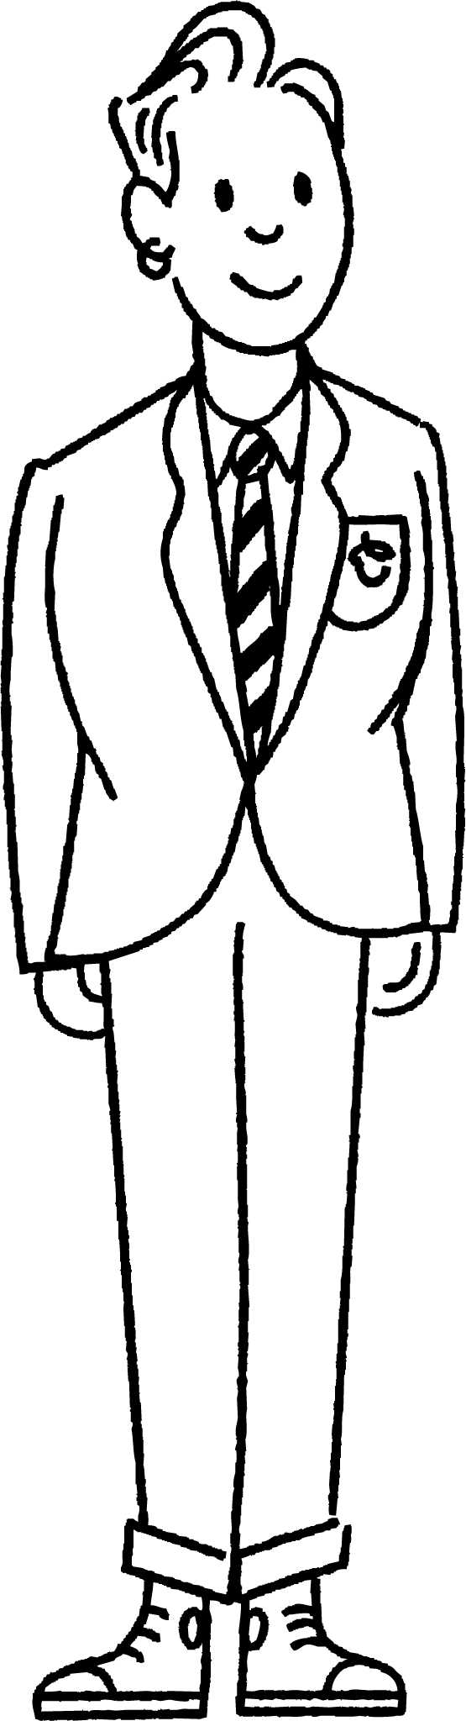
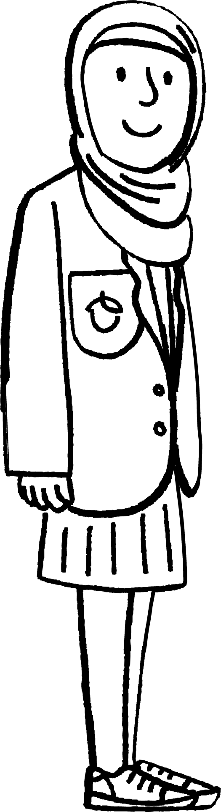
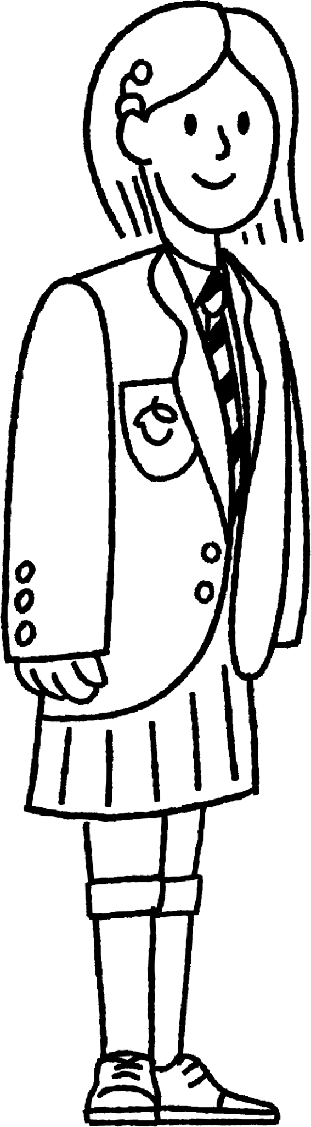
Finding the middle in small data sets
Here are seven Oak Academy pupils.
Sofia is in the middle - does she have the median height?
Izzy
Aisha
Andeep
Sofia
Sam
Jacob
Alex
No - the median needs to be representing the ‘typical’ height of the group. They need to be in height order first.

Slide 13
Finding the middle in small data sets
Here are seven Oak Academy pupils.
Sofia is in the middle - does she therefore have the median height?
Sofia
Aisha
Izzy
Sam
Jacob
Andeep
Alex
Sam is now the middle and Sam’s height is the median height for this group. Sam’s height is more ‘typical’.

Slide 14
Finding the middle in small data sets
What has Sam done wrong?
123, 105, 182, 63, 95
The median value is 182.
Sam has not ordered the data set first.

Slide 15
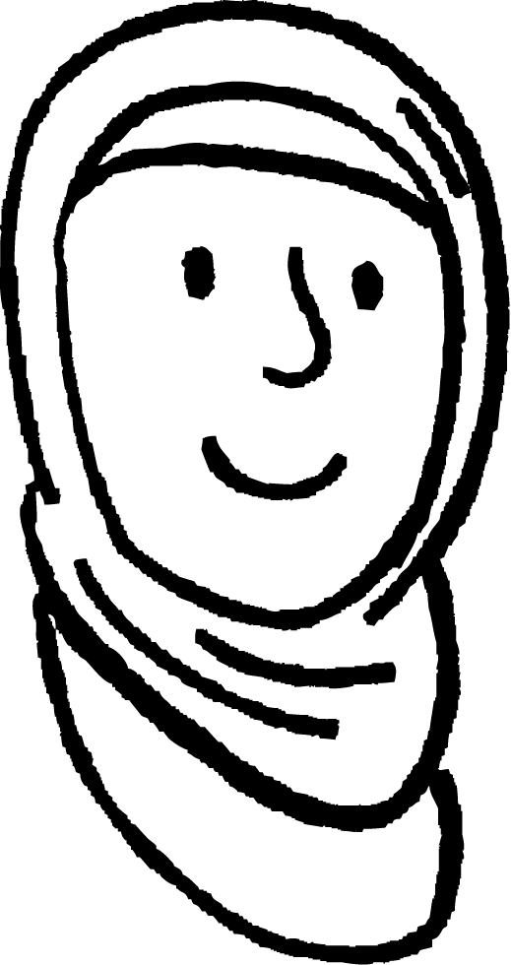
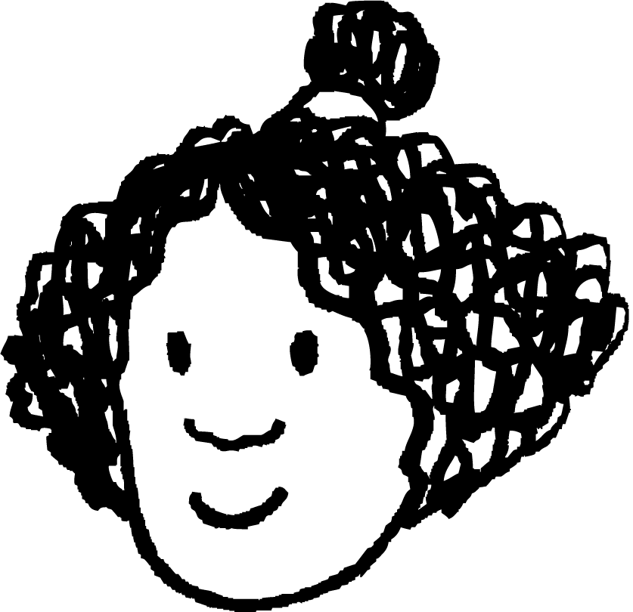
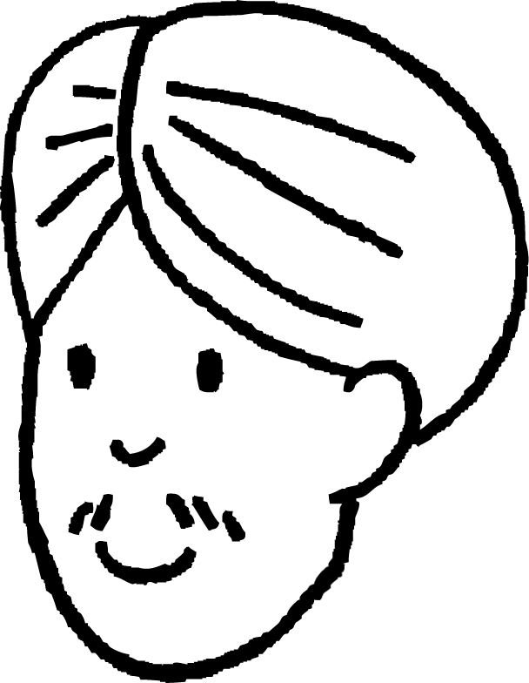


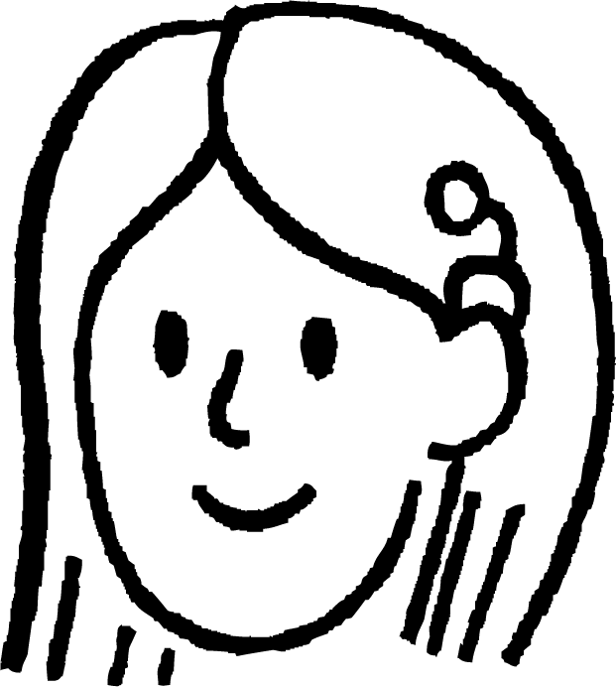

Finding the middle in small data sets
Here are some Oak Academy pupils and their favourite colours.
Aisha
Andeep
Izzy
Lucas
Jun
Sofia
Alex
red
blue
purple
blue
green
pink
orange
What is the median favourite colour?
Lucas is in the middle, his favourite colour is blue. However the pupils could have lined up in any order and then the middle would be different.
Colours do not have a defined order and therefore there is not a median.

Slide 16

Finding the middle in small data sets
For which of the following data sets can you find the median?
red, orange, yellow, green, blue, indigo, violet
3, 5, 1, 10, 2, 5, 7, 8, 12
–3.5, –3.1, –2.8, –2, –1.6, –1.02

Slide 17
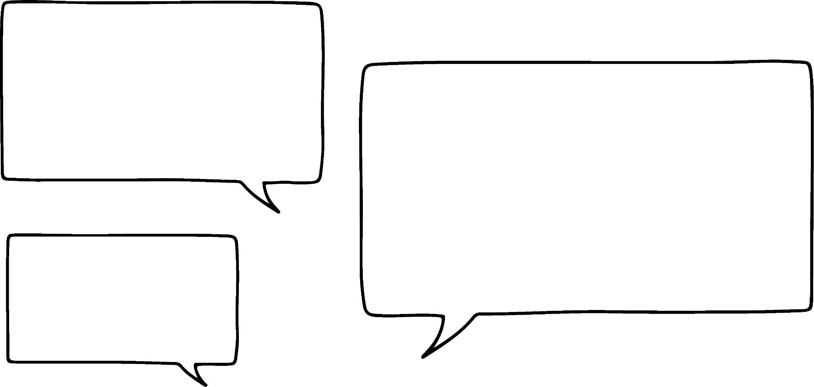
Finding the middle in small data sets
Data has been collected about the total sunshine hours in a year for Dunstaffnage.
1287.2, 1075.5, 1256, 1039.8, 1431.1, 1268.2, 1163.3
What is the median number of sunshine hours in a year?
First the data needs to be ordered, then the middle piece of data is located:
Work in from either end, cross off the data.
1039.8, 1075.5, 1163.3, 1256, 1268.2, 1287.2, 1431.1
The median is 1256 hours of sunshine in a year.
Jun

Slide 18
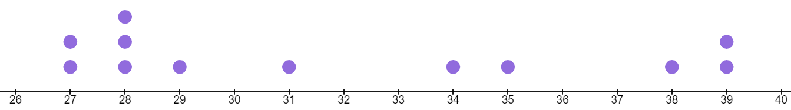
Finding the middle in small data sets
The data set: 27, 27, 28, 28, 28, 29, 31, 34, 35, 38, 39, 39 is shown on this dot plot.
There are 12 pieces of data which means there is not a piece of data that is in the ‘middle’.
There feels like three options for the median: 29, 30 or 31.
Which is most ‘average’?
30
it is the mean of the two central data points
it is the midpoint of the two central data points

Slide 19
Finding the middle in small data sets
Data has been collected monthly about mean daily maximum temperatures (°C) in Eastbourne during 2022.
9.7, 11, 11.8, 14.4, 17.9, 20.2, 24.3, 24.3, 20.3, 18.3, 13.9, 8.2
What is the median temperature?
First the data needs to be ordered, then the middle piece of data is located:
8.2, 9.7, 11, 11.8, 13.9, 14.4, 17.9, 18.3, 20.2, 20.3, 24.3, 24.3
Due to the even amount of data, the median is the mean of the two most central pieces of data.
The median is 16.15 °C

Slide 20
Finding the middle in small data sets
The median will always be a value in the data set.
It is the middle piece of data
When there are an even number of data points, the mean of the two central pieces is calculated

Slide 21
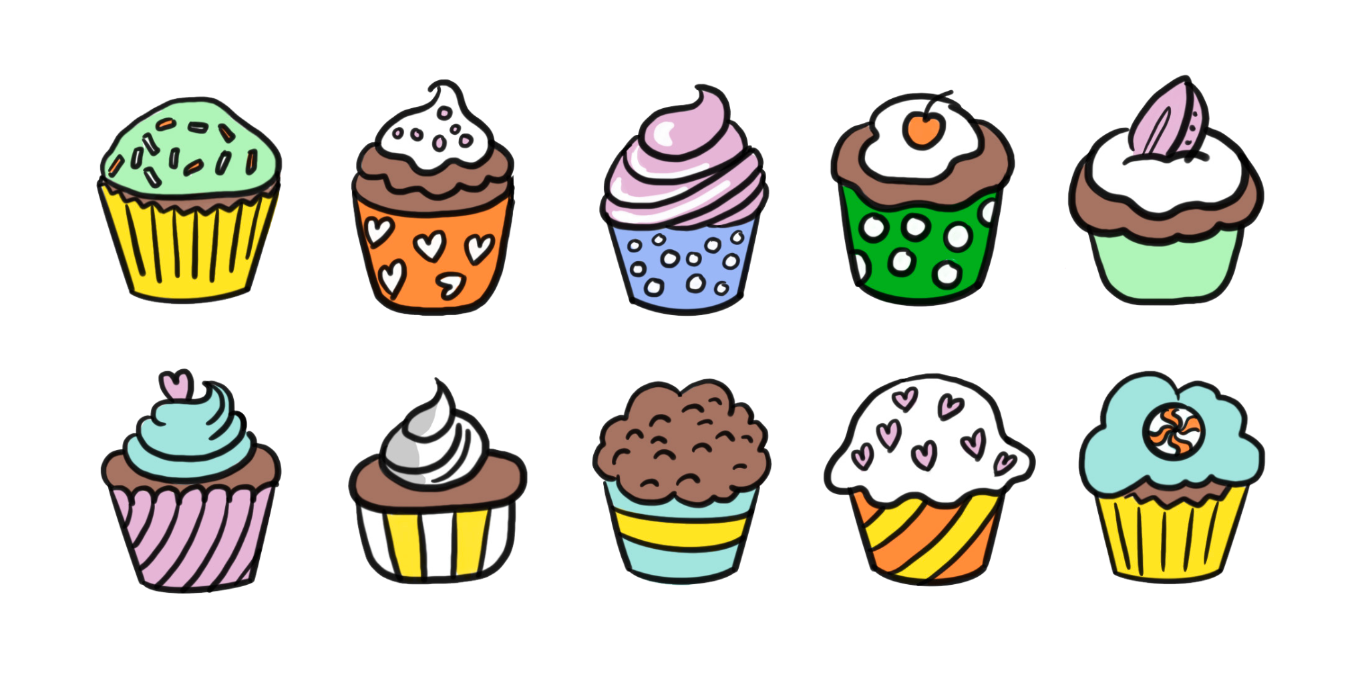
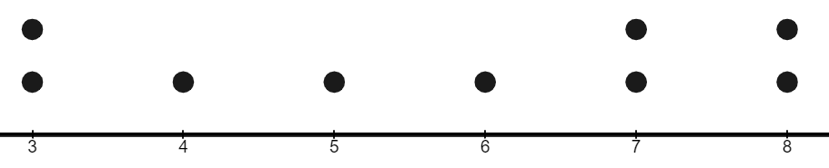
Finding the middle in small data sets
Each tray has some cupcakes. What is the median number of cupcakes?
Some data are shown on the dot plot. What is the median value?
3
4
5
6
7
8

Slide 22
Finding the middle in small data sets
If possible, find the median for these data sets
16, 32, 29, 19, 30, 42, 51, 29, 25, 28
avocado, beetroot, carrot, damson, edamame, fig
-3, -9, -3, -7, -2, -10, -1

Slide 23
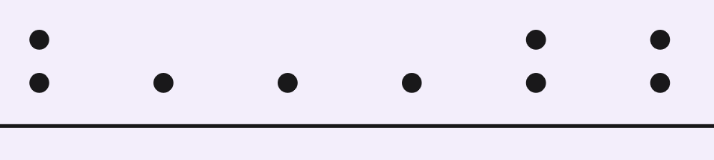
Finding the middle in small data sets
Each tray has some cupcakes. What is the median number of cupcakes?
4 cupcakes
2
3
4
5
6
Some data are shown on the dot plot. What is the median value?
6
3
4
5
6
7
8

Slide 24
Finding the middle in small data sets
If possible, find the median for these data sets
16, 32, 29, 19, 30, 42, 51, 29, 25, 28
avocado, beetroot, carrot, damson, edamame, fig
-3, -9, -3, -7, -2, -10, -1
16, 19, 25, 28, 29, 29, 30, 32, 42, 51 the median is 29
no median for these data
-10, -9, -7, -3, -3, -2, -1
the median is -3

Slide 25
Understanding the median
Finding the middle in small data sets
Finding the middle in large data sets

Slide 26
Finding the middle in large data sets
Here is some data regarding number of attendees at a team practice.
15, 13, 14, 15, 16,
16, 17, 12, 13, 14,
16, 16, 18, 15, 12
To find the median number of attendees we need to order the data first.
12, 12, 13, 13, 14,
14, 15, 15, 15, 16,
16, 16, 16, 17, 18
The median is 15.
Then we can work from the ends in towards the middle.
It becomes more difficult when the data are spread across multiple lines.

Slide 27
Finding the middle in large data sets
Here is some data regarding mean maximum daily temperatures in Cardiff Bute Park over a period of time.
4.4, 4.6, 5.4, 5.5, 5.7, 6, 6.2, 6.5, 6.6, 6.8, 7.5, 7.9, 8.2, 8.3, 8.4, 8.4, 8.8, 8.8, 8.8, 9.2, 9.5, 9.6, 9.6, 9.6, 9.8, 9.9, 9.9, 10.1, 10.2, 10.3, 10.3, 10.5, 10.6, 10.9, 10.9, 11.2, 11.3, 11.4, 11.6, 11.6, 11.8, 12.3, 12.5, 2.6, 13.2, 13.3, 13.3, 13.9, 13.9, 14.2, 14.2, 14.4, 14.5, 14.8, 15.3, 15.4, 15.4, 15.5, 16.1, 16.6, 16.6, 7.1, 17.3, 17.3, 17.4, 17.7, 17.7, 17.8, 18.2, 18.3, 18.3, 18.3, 18.4, 18.4, 18.5, 18.5, 18.7, 18.9, 18.9, 19, 19.1, 19.2, 19.3, 19.6, 20, 20, 20.1, 20.9, 20.9, 21.1, 21.2, 21.6, 22.1, 23.1, 23.3, 23.5, 25.9
To find the median by working towards the middle starts to be impractical as our data set increases.
Is there another way?

Slide 28
Finding the middle in large data sets
If there are three data points in order, which position is the median in?
1st
2nd
2nd
3rd
If there are five data points in order, which position is the median in?
1st
2nd
3rd
3rd
4th
5th
If there are nine data points in order, which position is the median in?
1st
2nd
3rd
4th
5th
5th
6th
7th
8th
9th
Is there a connection between the number of data points and the position of the median?

Slide 29

Finding the middle in large data sets
number of data points | position of the median
3 | 2
5 | 3
9 | 5
Add 1 to the number of data and then halve to get the position.
Halve the number of data and then add 0.5 to get the position.
Who is correct?
Jun
They are both correct.
Laura

Slide 30
Finding the middle in large data sets
So if there are 19 data points, which position is the median in?
19 ÷ 2 = 9.5
9.5 + 0.5 = 10
so the median is in the 10th position
19 + 1 = 20
20 ÷ 2 = 10
so the median is in the 10th position
Jun
Laura

Slide 31

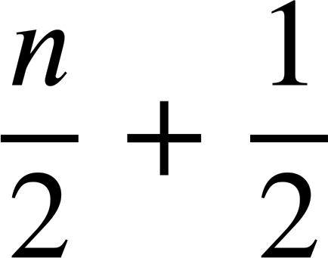
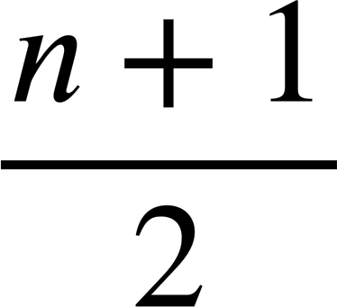
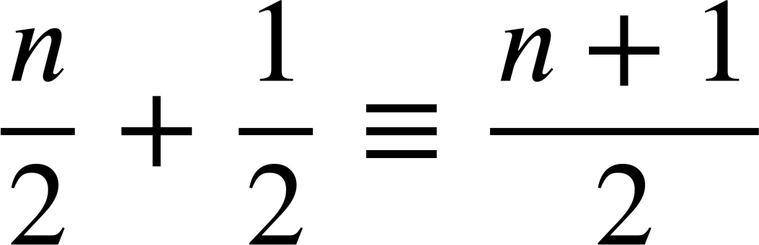
Finding the middle in large data sets
So if there are n data points, which position is the median in?
The median would be in the position.
The median would be in the position.
Jun has fractions with a common denominator so as a single fraction it is the same as Laura’s.
Jun
Laura

Slide 32
Finding the middle in large data sets
A data set has 431 pieces of data.
What is the position of the median?
431 + 1 = 432
432 ÷ 2 = 216
216th position

Slide 33
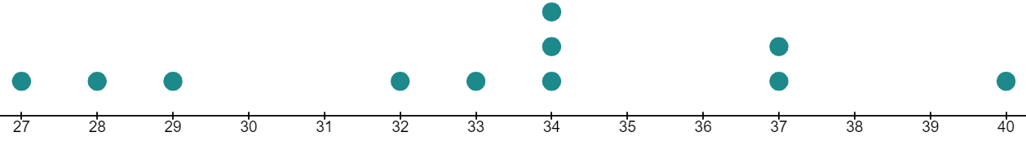
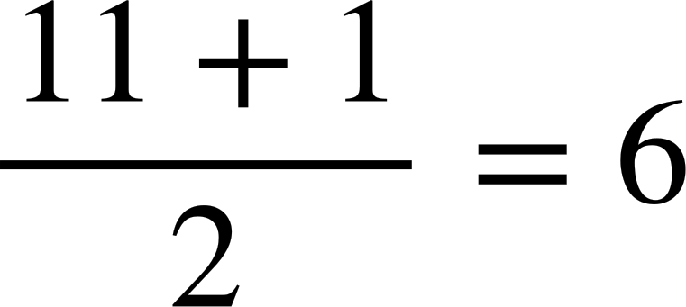
Finding the middle in large data sets
This dot plot represents a set of data.
There are 11 data points.
The median is in the ^{th} position.
The median is 34.

Slide 34
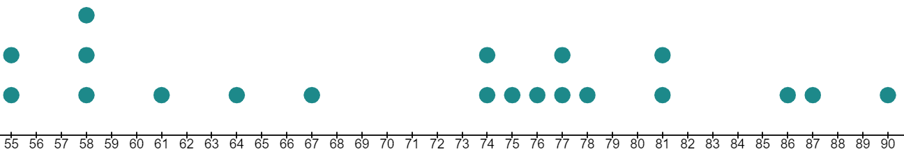
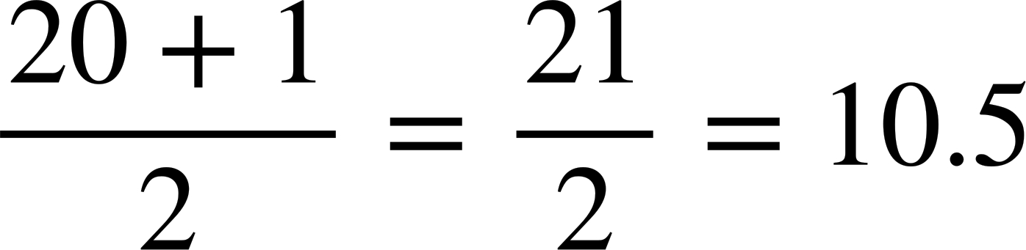
Finding the middle in large data sets
There are 20 pieces of data represented on this dot plot.
The median is in the ^{th} position.
So the mean of the 10th and 11th pieces of data.
The mean of 74 and 75 is 74.5, the median is 74.5

Slide 35
Finding the middle in large data sets
A data set has 5320 pieces of data.
Between which two pieces of data, does the median value lie?
5320 + 1 = 5321
5321 ÷ 2 = 2660.5
2660.5th position which is between 2660th piece of data and the 2661st piece of data

Slide 36
Finding the middle in large data sets
1) Work out the position of the median in each case:
a) 425 data points
b) 327 data points
c) 2389 data points
d) 412 data points
e) 5686 data points

Slide 37
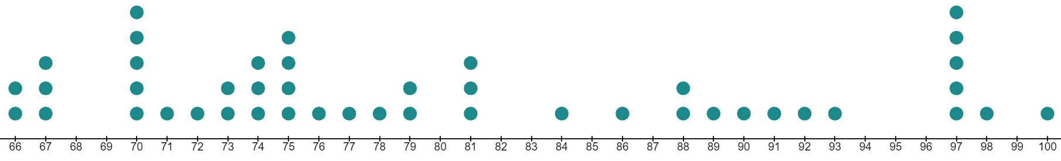
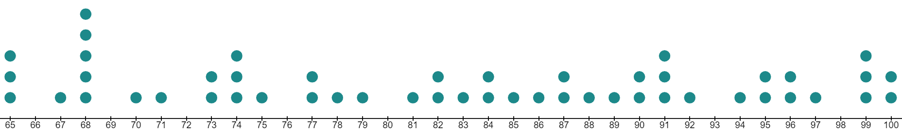
Finding the middle in large data sets
2) Work out the median from each dot plot
a)
b)

Slide 38
Finding the middle in large data sets
3) Here there are 97 pieces of data in order.
4.4, 4.6, 5.4, 5.5, 5.7, 6, 6.2, 6.5, 6.6, 6.8, 7.5, 7.9, 8.2, 8.3, 8.4, 8.4, 8.8, 8.8, 8.8, 9.2, 9.5, 9.6, 9.6, 9.6, 9.8, 9.9, 9.9, 10.1, 10.2, 10.3, 10.3, 10.5, 10.6, 10.9, 10.9, 11.2, 11.3, 11.4, 11.6, 11.6, 11.8, 12.3, 12.5, 12.6, 13.2, 13.3, 13.3, 13.9, 13.9, 14.2, 14.2, 14.4, 14.5, 14.8, 15.3, 15.4, 15.4, 15.5, 16.1, 16.6, 16.6, 17.1, 17.3, 17.3, 17.4, 17.7, 17.7, 17.8, 18.2, 18.3, 18.3, 18.3, 18.4, 18.4, 18.5, 18.5, 18.7, 18.9, 18.9, 19, 19.1, 19.2, 19.3, 19.6, 20, 20, 20.1, 20.9, 20.9, 21.1, 21.2, 21.6, 22.1, 23.1, 23.3, 23.5, 25.9
What is the median value?
4) There are 2000 items in the data set in total. The part of the list shown starts at the 998th entry. What is the median for this data set?
…, –4.5, –4.5, –4.2, –3.9, –3.3, –2.1, –2.0, –0.8, –0.1, 0, 0, 0.2, 0.2, 0.2, 1.7, 1.8, …
998th

Slide 39
Finding the middle in large data sets
1) Work out the position of the median in each case
a) 425 data points
b) 327 data points
c) 2389 data points
d) 412 data points
e) 5686 data points
213th piece of data
164th piece of data
1195th piece of data
206.5th piece of data
- the mean of the 206th and 207th data values
2843.5th piece of data - the mean of the 2843rd and 2844th data values

Slide 40
Finding the middle in large data sets
Work out the median from each dot plot
a)
77
b)
83.5

Slide 41
Finding the middle in large data sets
Here there are 97 pieces of data in order.
4.4, 4.6, 5.4, 5.5, 5.7, 6, 6.2, 6.5, 6.6, 6.8, 7.5, 7.9, 8.2, 8.3, 8.4, 8.4, 8.8, 8.8, 8.8, 9.2, 9.5, 9.6, 9.6, 9.6, 9.8, 9.9, 9.9, 10.1, 10.2, 10.3, 10.3, 10.5, 10.6, 10.9, 10.9, 11.2, 11.3, 11.4, 11.6, 11.6, 11.8, 12.3, 12.5, 12.6, 13.2, 13.3, 13.3, 13.9, 13.9, 14.2, 14.2, 14.4, 14.5, 14.8, 15.3, 15.4, 15.4, 15.5, 16.1, 16.6, 16.6, 17.1, 17.3, 17.3, 17.4, 17.7, 17.7, 17.8, 18.2, 18.3, 18.3, 18.3, 18.4, 18.4, 18.5, 18.5, 18.7, 18.9, 18.9, 19, 19.1, 19.2, 19.3, 19.6, 20, 20, 20.1, 20.9, 20.9, 21.1, 21.2, 21.6, 22.1, 23.1, 23.3, 23.5, 25.9
What is the median value?
The piece of data in the 49th position → 13.9
4) There are 2000 items in the data set in total. The part of the list shown starts at the 998th entry. What is the median for this data set?
…, –4.5, –4.5, –4.2, –3.9, –3.3, –2.1, –2.0, –0.8, –0.1, 0, 0, 0.2, 0.2, 0.2, 1.7, 1.8, …
Median = -4.05
998th

Slide 42
Understanding the median
The median is a measure of central tendency.
The median is the middle (or average middle) value in an ordered data set. The position of the median can be found using , where is the number of data values.

Slide 43

© Oak National Academy 2023.
Produced in partnership with Mathematics in Education and Industry.
Licensed on the Open Government Licence v3.0, except where otherwise stated. See Oak terms and conditions.

